Slide 1


Diogo Rezende
10/15/2024

Slide 2

Outline
Executive Summary
Introduction
Methodology
Results
Conclusion
Appendix

Slide 3
Executive Summary
Summary of methodologies
Data Collection using API
Data Collection using Web Scraping
Data Wrangling
Exploratory Data Analysis with SQL
Exploratory Data Analysis with Data Visualization
Interactive Visual Analytics with Folium
Machine Learning Prediction

Slide 4
Introduction
In this project I’ll take on the role of a data scientist for a rocket company to determine the success or failure of rocket landings.

Slide 5

Section 1

Slide 6
Methodology
Executive Summary
Data collection methodology:
Get requests to the Space X API and web scraping from Wikipedia.
Perform data wrangling
Data Cleaning and Pre-processing
Perform exploratory data analysis (EDA) using visualization and SQL
Perform interactive visual analytics using Folium and Plotly Dash
Perform predictive analysis using classification models
How to build, tune, evaluate classification models

Slide 7
Data Collection
The data was collected using:
Space X API
Web Scraping

Slide 8
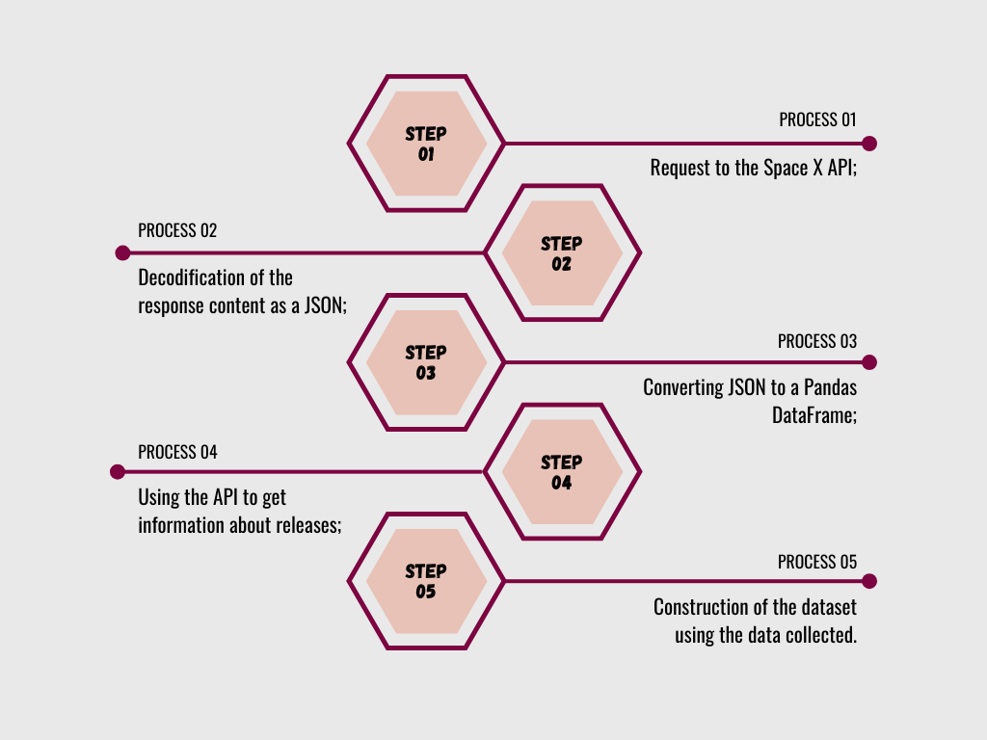
Data Collection – SpaceX API
The data was collected following the steps that are displayed in the graph on the side.
GitHub link for the full project: https://github.com/diiogorezende/IBM-Data-Science-Certificate/tree/main/09%20-%20Applied%20Data%20Science%20Capstone
Place your flowchart of SpaceX API calls here

Slide 9
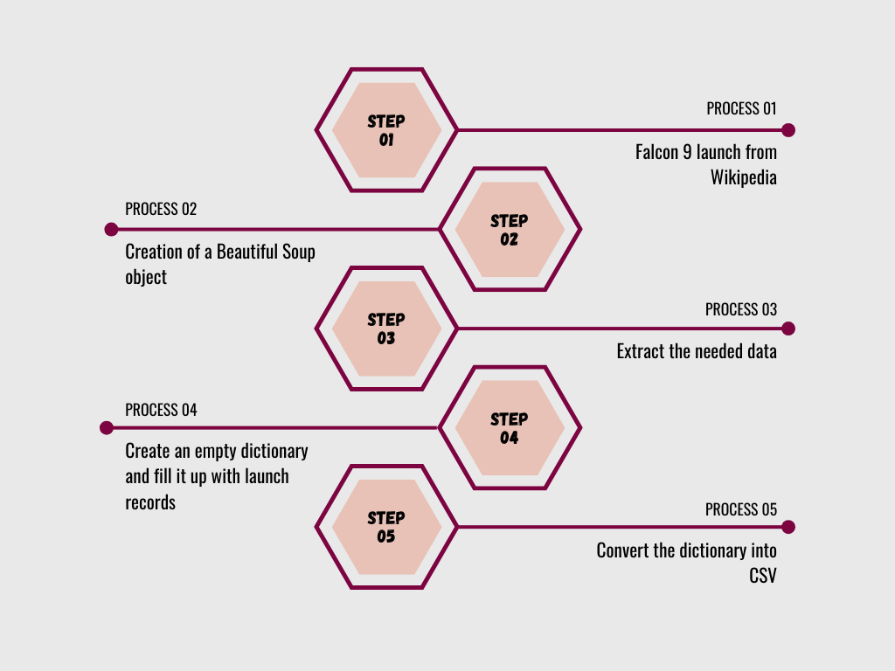
Data Collection - Scraping
The data was collected following the steps that are displayed in the graph on the side.
GitHub link for the full project: https://github.com/diiogorezende/IBM-Data-Science-Certificate/tree/main/09%20-%20Applied%20Data%20Science%20Capstone
Place your flowchart of web scraping here

Slide 10
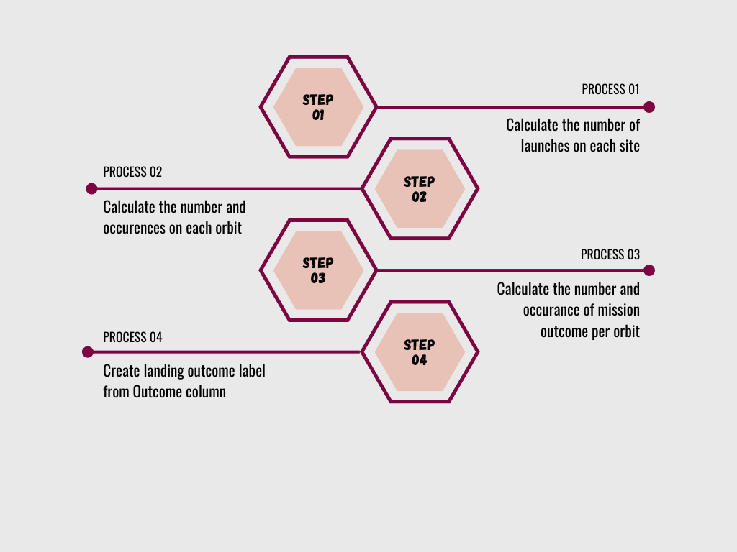
Data Wrangling
The data wrangling was done following the steps that are displayed in the graph on the side.
GitHub link for the full project: https://github.com/diiogorezende/IBM-Data-Science-Certificate/tree/main/09%20-%20Applied%20Data%20Science%20Capstone

Slide 11
EDA with Data Visualization
The charts used were:
Scatter plots;
Bar charts;
Line plots.
GitHub link for the full project: https://github.com/diiogorezende/IBM-Data-Science-Certificate/tree/main/09%20-%20Applied%20Data%20Science%20Capstone

Slide 12
EDA with SQL
The SQL queries used were:
Display number of unique launch sites;
Display 5 records where launch sites begin with CCA;
Display total payload mass carried by NASA (CRS);
Display average payload mass carried by F9 v1.1;
List the date when first successful landing occur;
List the number of success and failure outcomes;
List the names of the booster versions which carried the maximum payload mass;
List the failed outcomes in drone ship, their booster versions, and launch site names;
Rank the count of landing outcomes
GitHub link for the full project: https://github.com/diiogorezende/IBM-Data-Science-Certificate/tree/main/09%20-%20Applied%20Data%20Science%20Capstone

Slide 13
Build an Interactive Map with Folium
Folium Markers were used to show Space X launch sites and their nearest landmarks like railways, highways, cities, and coastlines.
Polylines were used to connect the launch sites to their nearest landmarks.
Red represents rocket launch failures
Green represents the successes
GitHub link for the full project: https://github.com/diiogorezende/IBM-Data-Science-Certificate/tree/main/09%20-%20Applied%20Data%20Science%20Capstone

Slide 14
Build a Dashboard with Plotly Dash
Pie charts and scatter charts were used to visualize the launch records of Space X.
These charts displayed the rocket launch success rate per launch site. We are able to get an understanding of the factors that may have influence on the success rate.
GitHub link for the full project: https://github.com/diiogorezende/IBM-Data-Science-Certificate/tree/main/09%20-%20Applied%20Data%20Science%20Capstone

Slide 15
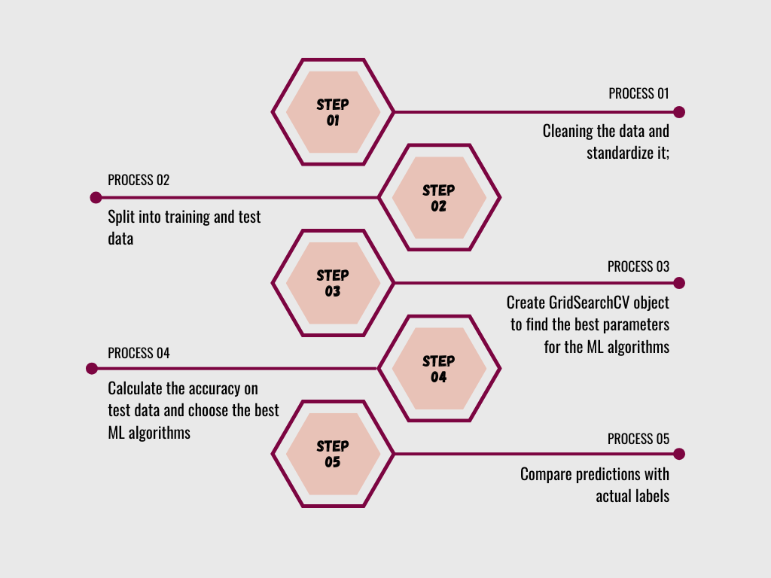
Predictive Analysis (Classification)
The model was builted using the Scikit-learn library for make the predictions.
GitHub link for the full project: https://github.com/diiogorezende/IBM-Data-Science-Certificate/tree/main/09%20-%20Applied%20Data%20Science%20Capstone

Slide 16
Results
The EDA show that successful landing outcomes area correlated with flight number. Also show an increase landing outcome since 2015.
All the graphs and charts can be found on the GitHub Repo.
The predictive analysis results showed an accuracy rate of 83.33%

Slide 17

Section 2

Slide 18
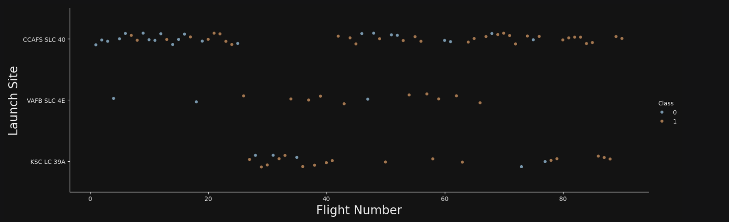
Flight Number vs. Launch Site
Show a scatter plot of Flight Number vs. Launch Site
Seems like the success rate increases when the flight number also increases.

Slide 19
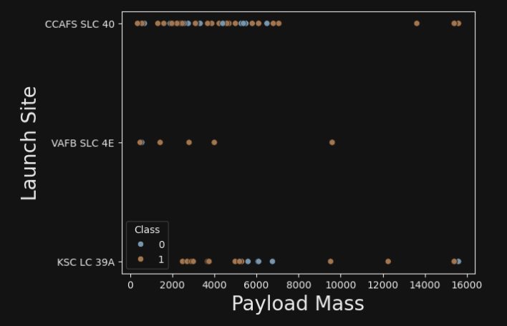
Payload vs. Launch Site
Show a scatter plot of Payload vs. Launch Site
Havier payload mass seems to have a better success rate.

Slide 20
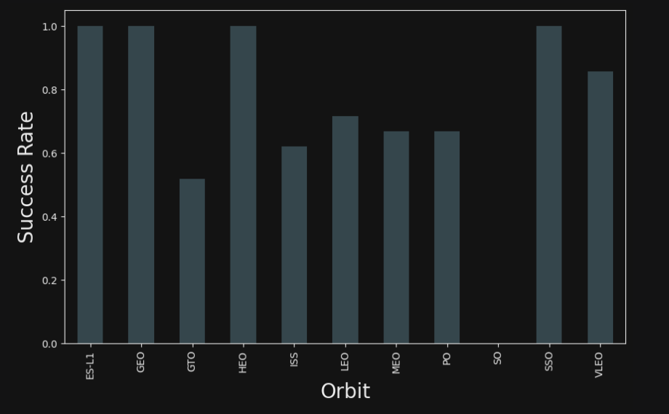
Success Rate vs. Orbit Type
Show a bar chart for the success rate of each orbit type
We can see that the greatest success rates are in the following orbits: ES-L1, GEO, HEO, SSO. With a success rate near to 1.

Slide 21
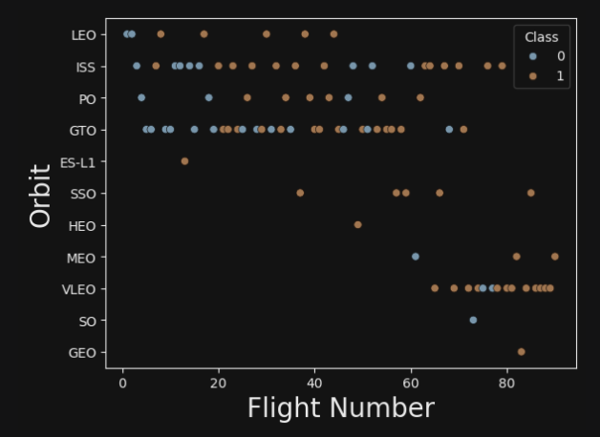
Flight Number vs. Orbit Type
Show a scatter point of Flight number vs. Orbit type
It seems that the more flight numbers, the greater the amount of success in the given orbit.

Slide 22
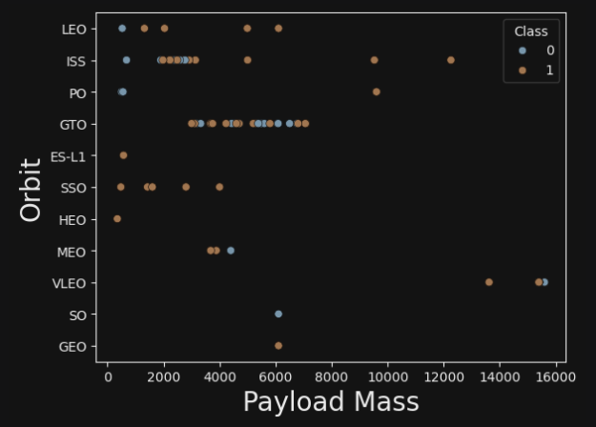
Payload vs. Orbit Type
Show a scatter point of payload vs. orbit type
In the same way it seems that the more payload mass, the greater the amount of success in the given orbit.
Only for the GTO orbit there seems to be no relationship.

Slide 23
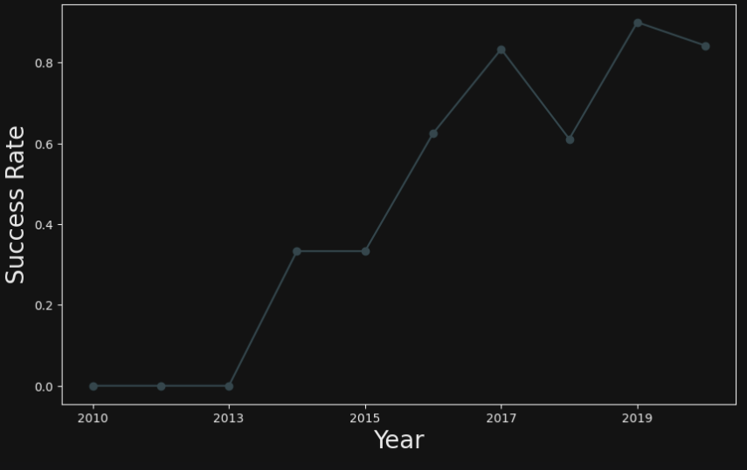
Launch Success Yearly Trend
Show a line chart of yearly average success rate
We can see that from 2013 onwards there was a significant increase in the success rate, followed by another increase from 2015 onwards.

Slide 24
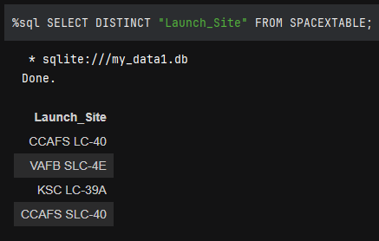
All Launch Site Names
Find the names of the unique launch sites
The following table show all the launch site names.

Slide 25
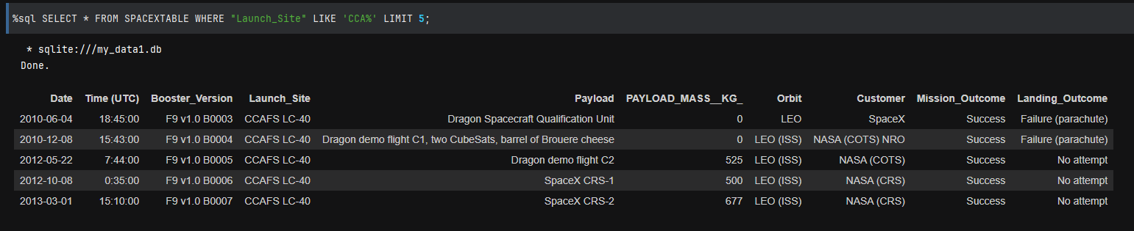
Launch Site Names Begin with 'CCA'
Find 5 records where launch sites begin with `CCA`
The following table show us the launch sites that begins with “CCA”. If we look carefully, is possible to see that not only Space X uses those Launch Sites.

Slide 26
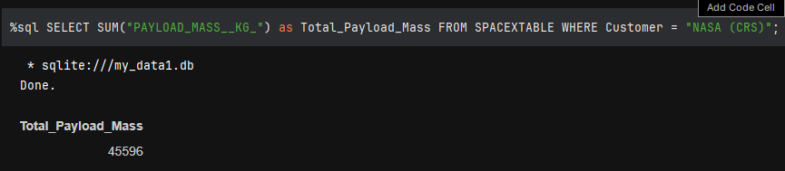
Total Payload Mass
Calculate the total payload carried by boosters from NASA
The following table show us the total payload mass carried by NASA.

Slide 27
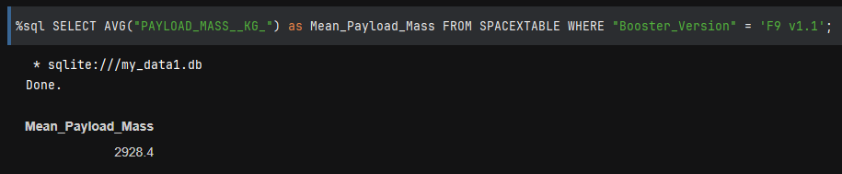
Average Payload Mass by F9 v1.1
Calculate the average payload mass carried by booster version F9 v1.1
The following table show us the average payload mass carried by F9 v1.1

Slide 28
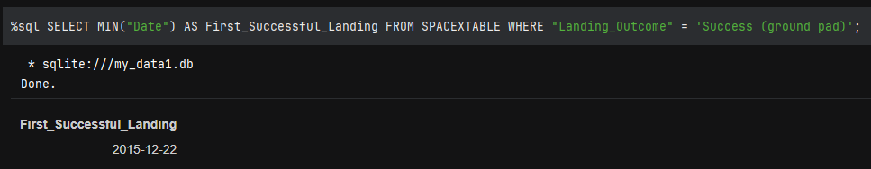
First Successful Ground Landing Date
Find the dates of the first successful landing outcome on ground pad
The first success occurred on 12/22/2015

Slide 29
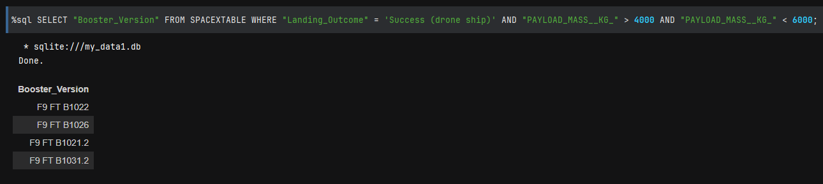
Successful Drone Ship Landing with Payload between 4000 and 6000
List the names of boosters which have successfully landed on drone ship and had payload mass greater than 4000 but less than 6000
Query showing the drone ship landing with the payload between 4000 and 6000.

Slide 30
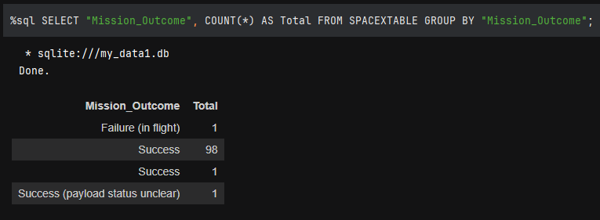
Total Number of Successful and Failure Mission Outcomes
Calculate the total number of successful and failure mission outcomes
We can see a very high success outcome.

Slide 31
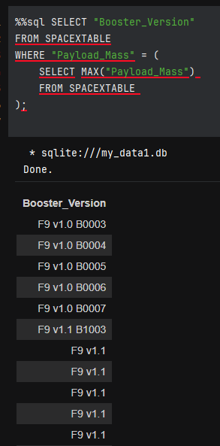
Boosters Carried Maximum Payload
List the names of the booster which have carried the maximum payload mass

Slide 32
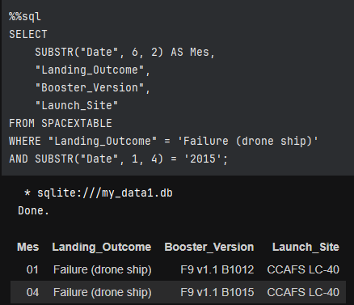
2015 Launch Records
List the failed landing_outcomes in drone ship, their booster versions, and launch site names for in year 2015

Slide 33
Rank Landing Outcomes Between 2010-06-04 and 2017-03-20
Rank the count of landing outcomes (such as Failure (drone ship) or Success (ground pad)) between the date 2010-06-04 and 2017-03-20, in descending order
Present your query result with a short explanation here

Slide 34

Section 3

Slide 35
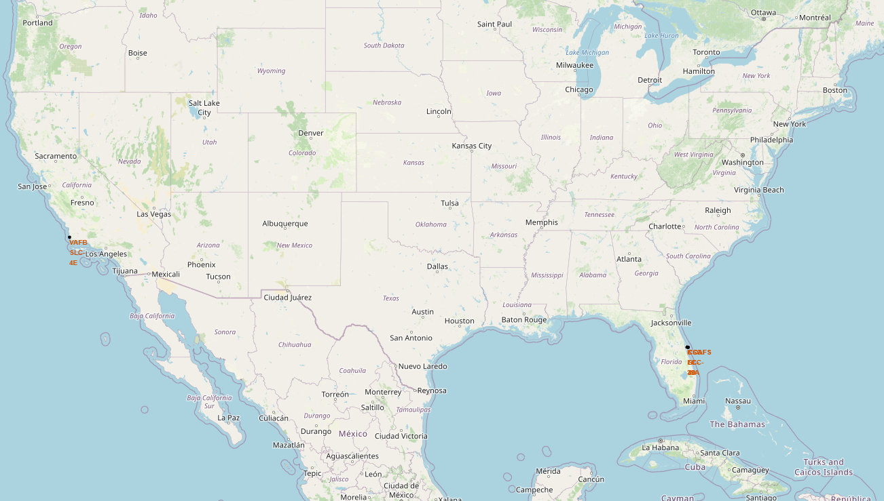
Launch Sites
We can see that the launch sites are close to the coast.

Slide 36
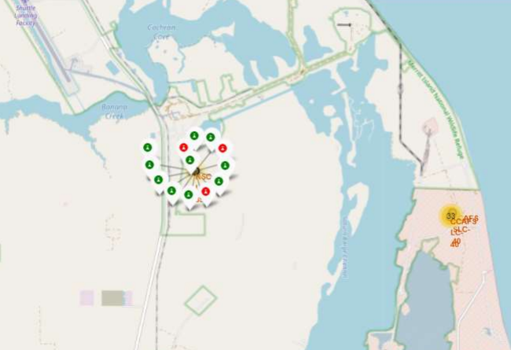
Success and Failures
Successes in green, failures in red.

Slide 37
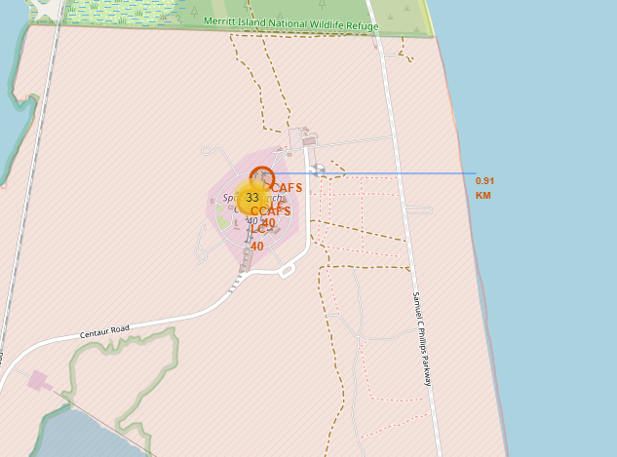
Proximity to the coast
That image show us the proximity to the coast.

Slide 38

Section 4

Slide 39
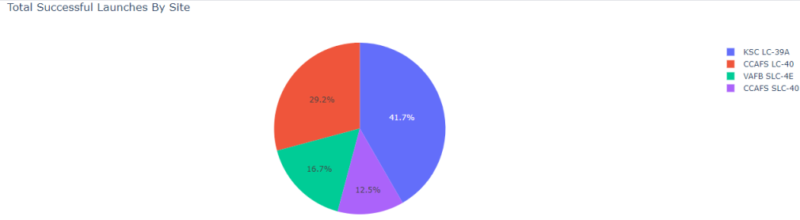
Successful Launchs in with Plotly
The most successful launch site is KSC LC-39A.

Slide 40
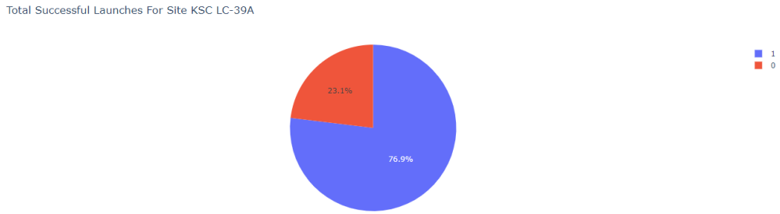
KSC LC-39A success rate
The graph show us the success rate for the KSC LC-39A

Slide 41
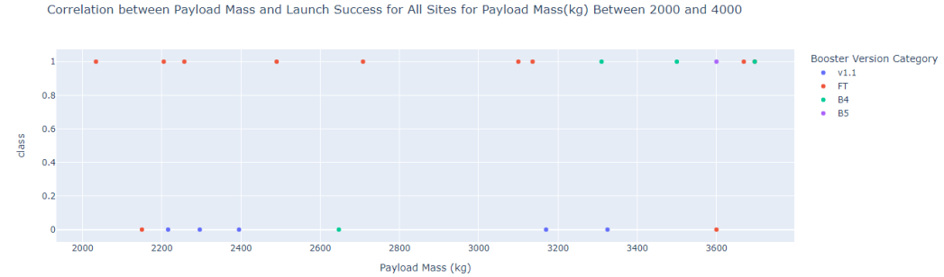
Payload mass and Launch success
Replace <Dashboard screenshot 3> title with an appropriate title

Slide 42

Section 5

Slide 43
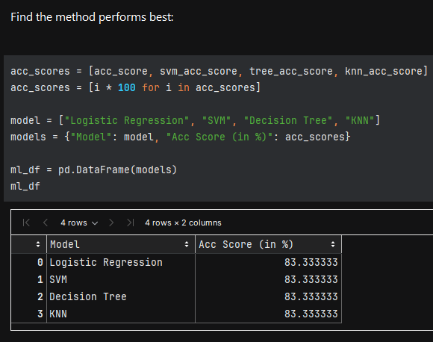
Classification Accuracy
All the algorithms have the same accuracy of 83.33%.
In these case, we would choose the logistic regression, because it is a lighter algorithm.

Slide 44
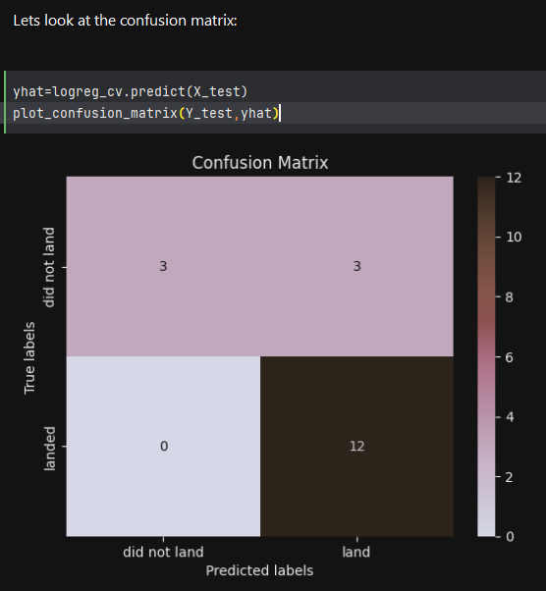
Confusion Matrix
The image at the side show us the confusion matrix for the Logistic Regression algorithm.

Slide 45
Conclusions
Logistic Regression was chosen because is a lighter algorithm.
Launch sites are near coast and away from cities.
2013 onwards there was a significant increase in the success rate, followed by another increase from 2015 onwards.
All algorithms had an accuracy of 83.33%

Slide 46


